Slide 1

Invest NYC SDG Initiative
A Finance Map of NYC: Reducing Carbon and Driving Large Scale Energy Efficiency with a Public Database To Support PACE Lending
- A CUSP Capstone project -
March 4, 2021

Slide 2
Agenda
Introductions of the team
Introductions of the CUSP students
Project orientation
Initial assignments

Slide 3


Invest NYC SDG: Supporting Sustainability in NYC
The Center for Sustainable Business launched Invest NYC SDG in 2019 to help New York City achieve its ambitious sustainability goals with private sector engagement and investment.
As the first city in the world to align its sustainability goals with the UN Sustainable Development Goals (SDGs), NYC is in the forefront of finding solutions to the world’s challenges
Our goal is to identify and develop opportunities to advance the SDG agenda in NYC through a combination of private and public investment and partnerships across the city looking at six primary areas:

Slide 4

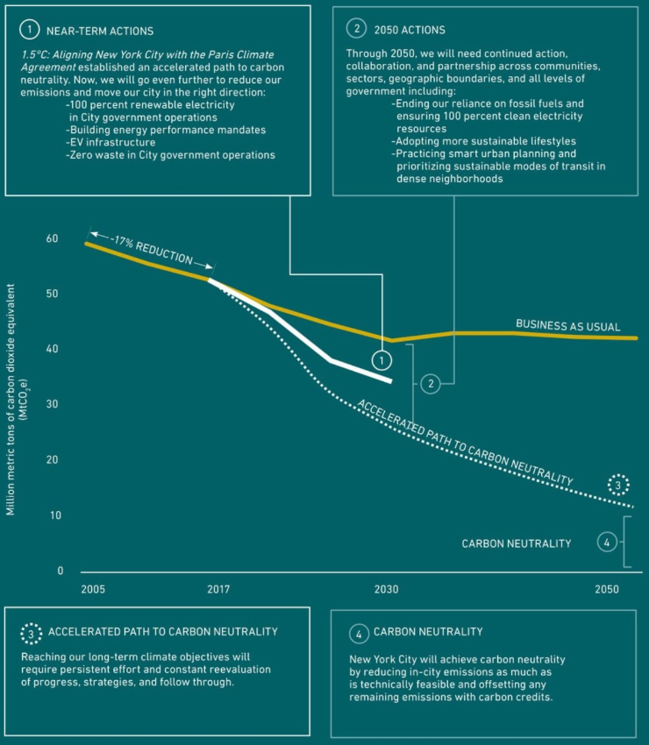
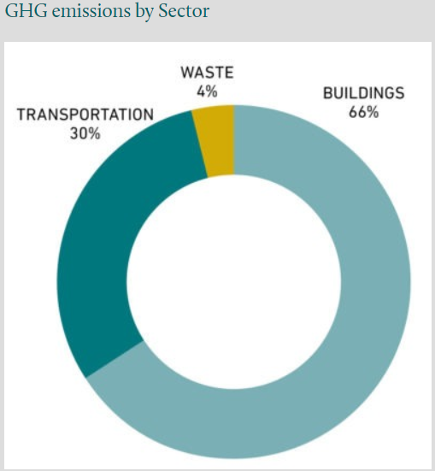
NYC goal: Reduce carbon emissions 80% by 2050
NYC goal: OneNYC 2050, presented the Roadmap to 80x50, with the goal of reducing 80% of the 2005 levels of emissions by 2050.
One million buildings produce around 66% of GHG of NYC.

Slide 5
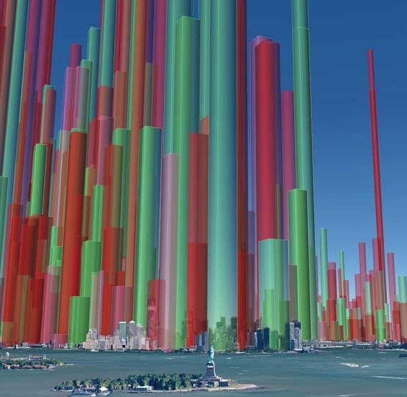
NYC goal: Reduce carbon emissions 80% by 2050
NYC enacted the Climate Mobilization Act in 2019 -- the most ambitious climate legislation of any city in the US. The Act includes:
Local Law 97 – Building Greenhouse Gas Emissions
Mandates emission reductions through energy efficient retrofits and applies penalties beginning 2024 to 30,000 buildings >25,000+ sq/ft,
Predicted to create 140,000+ NYC jobs in the next decade.
Requiring $16.6 B to $24.3 B in private investment.
Local Law 96 –Commercial Property Assessed Clean Energy (C-PACE)
Long-term, low-cost financing, repaid via the property tax bill.
Will be launched this year and will be administered by the NYC Energy Efficiency Corporation (NYCEEC) on behalf of the Mayor’s Office of Sustainability (MOS).

Slide 6
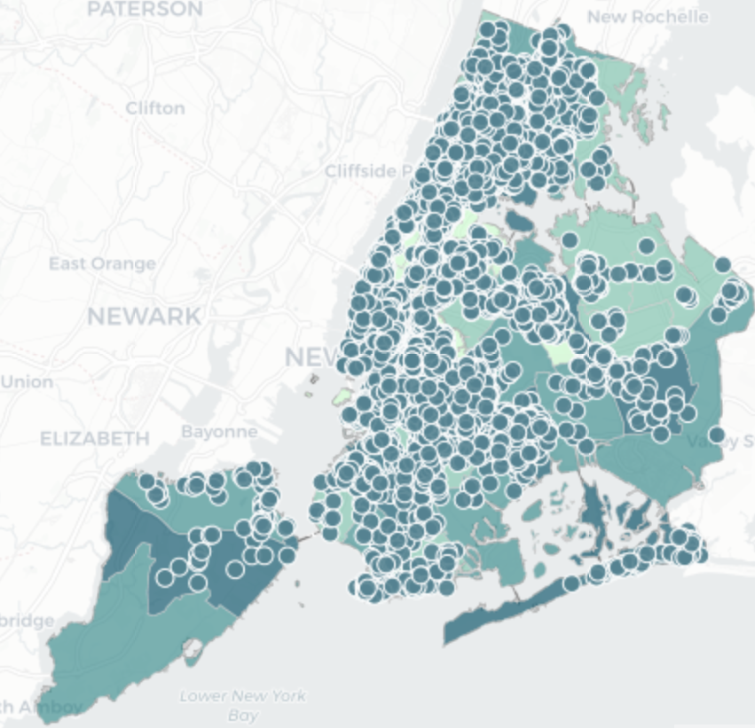
The Opportunity: expanding energy efficiency with PACE
Invest NYC SDG goal: Support NYC’s PACE financing program, enabling increased investment in clean energy/energy efficiency infrastructure by NYC property owners.
Working closely with MOS/NYCEEC:
Create a Public database and map LL97/PACE eligible buildings by:
GHG intensity
Ownership
Mortgage holder(s)
Applicable penalties under LL97
2. Prioritize “worst” buildings and develop/implement “linchpin” outreach strategies to (a) gain consent from underlying mortgage holders to accept PACE loan seniority and (b) increase building owner participation in PACE.
3. Conduct targeted outreach to key players to unlock engagement.

Slide 7
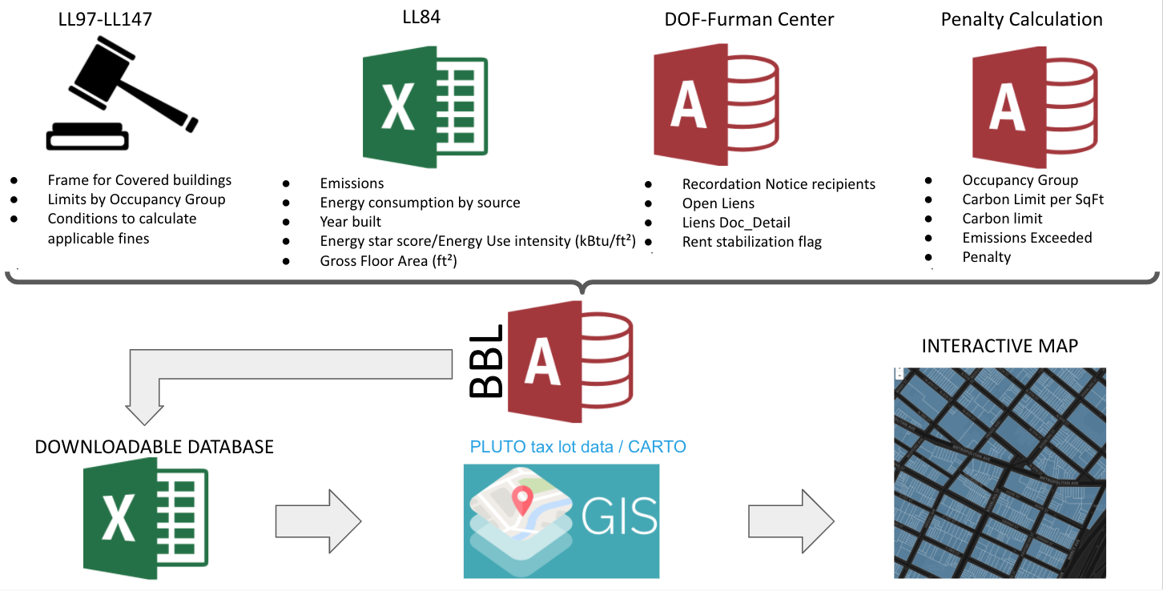

The Database

Slide 8
Orientation
Project goal: Support the implementation of a website available to the public
Design an application that can be easily navigated by the user.
Determine the filters that should be used to display subsets of the data on a map.
Employ data visualization tools to create visual representations of large data sets that describe NYC buildings.
Develop techniques to “pierce” the LLC veil and identify the actual owners of carbon intense buildings?
Consider what else can be done with the data?

Slide 9
Orientation
Some background:
Data we have captured in an SQL database
Access to the database
Additional data we seek (ownership of LLC, lien in CMBS, retrofit prescription)
The APPGEO application

Slide 10
Orientation
The analyses we want users to be able to perform (the queries):
Rank buildings by total carbon
Rank buildings by carbon intensity
Sort buildings into groups of buildings under common ownership
Rank ownership groups by total carbon
Rank lenders by carbon intensity
Rank lenders by total carbon
Sort building into occupancy groups
Rank occupancy groups by total carbon
Rank occupancy groups by carbon intensity
Rank buildings by total 2024, 2030 & 2035 fines
Rank buildings by 2024, 2030 & 2035 fines per square foot
Rank NYC agencies by total carbon
Rank NYC agencies by carbon intensity
Rank by energy source and use
Rank by efficiency score

Slide 11
Orientation
Some queries that can be obtained after a connection with PLUTO and other sources:
1) By whether located in historic district
2) By whether located in Opportunity Zone
3) By demographics and neighborhood
4) By Council district, Congressional district
5) Identifies whether it is occupied by a CIG.

Slide 12
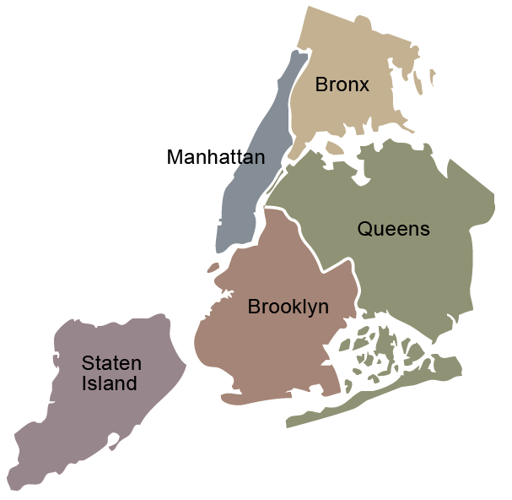
Building the new PACE lending program
PACE
Increase critical energy efficiency building retrofits
Create thousands of new green jobs
Advance the single largest opportunity to reduce carbon emissions in NYC

